Slide 1

Class Curriculum Information
CLASS NOTICES
Reading
Reading books will be coming home with your child to share with you. They will read to an adult in the classroom everyday and we hope that parents will do the same at home. Please ensure reading books come back to school on a Wednesday so they can be changed. A new book will be sent home on these days.
PE.
PE will take place on a Tuesday. Please remember our PE kit is black shorts, leggings or joggers and white t-shirt and trainers. Children need to come to school in their kit on PE days.
Homework
When the children have settled into school we will be introducing letter sounds. These letter sounds will be sent home as homework. This is so the children can practice them at home to reinforce their knowledge and understanding. We will be encouraging the children to apply these letter sounds when reading and writing.
Please regularly check tapestry for updates and information.
Year EYFS
Autumn Term 1
2025/2026

Slide 2



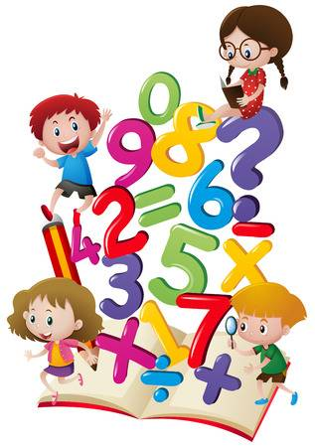

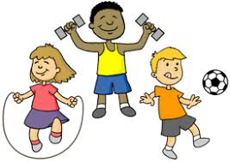
ENRICHMENT AREAS OF LEARNING
ENRICHMENT AREAS OF LEARNING
Literacy | This term we will start our phonics lessons and focus on writing our names. Through literacy lessons we will be writing about different things which make us special including birthdays and our family. There is a writing table and book corner and lots of writing opportunities in the outdoor area to encourage the children to read and write independently.
Maths | In this area of learning we will be exploring numbers and will have a number each week which we will focus on. We will be counting objects accurately and matching the total to a number. Wherever possible we will be linking mathematics to our topic, we will be ordering Autumn leaves according to their size and using the correct mathematical language to describe them. Activities will also be carried out using 2D shapes for example making houses with 2D shapes and learning what their names and properties are.
Forest School | The children will have the opportunity to explore the world around them. Eyrescroft Forest School is run completely within the school grounds; utilising the ‘wooded area’ to the rear of the school field. Children will have a weekly session. Please could your child bring welly boots in to keep in school.
R.E. | When looking at celebrations during this topic we will be finding out about different festivals and celebrations, for example Harvest, Diwali and Bonfire Night.
EAD | During the first half term, the children will have the opportunity to engage in role play, use musical instruments and explore colour. We will be painting self portraits and using junk modelling.
P.E. | Our PE will focus on listening and following instructions when playing games and working cooperatively. We will also begin to discuss healthy choices.

