Slide 1

Class Curriculum Information
CLASS NOTICES
Class Text
Our class texts are: ‘Grandad’s secret giant’ by David and ‘The First Flight’ by katie Wooley
‘Reading
The children will read for at least 10 minutes every day in school and we hope parents will do the same at home. The children will have a levelled reader that will be changed weekly. They will also have a reading for pleasure book that they can change whenever they wish. Both can be commented on in their reading diary.
PE
PE will take place on a Wednesday and Friday.
Children may come to school in their kit on PE days. They will be wearing this kit outside at lunch and playtimes so please ensure it is weather appropriate.
Homework
Our homework will be sent out every Friday returning back into school by the following Wednesday. If you have any questions about the homework, please ask.
Please ensure your child brings in a named water bottle everyday.
Year 2
Autumn Term 2
2025/2026

Slide 2


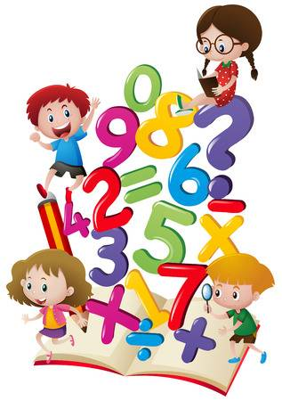
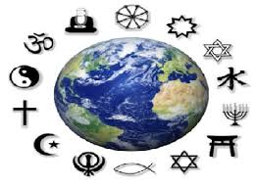
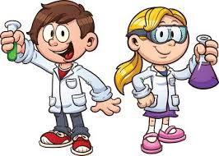


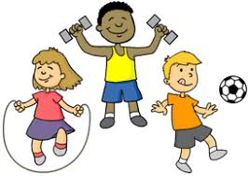
ENRICHMENT AREAS OF LEARNING
ENRICHMENT AREAS OF LEARNING
English | In reading this term we will be focusing on reinforcing the skills for answering questions linked to the text read. Our writing will see us looking at the ingredients of a good sentence and how we can add more details to make it more interesting.
Maths | In Maths we will be developing our adding and subtracting skills using two digit numbers. We will use a range of strategies including partitioning. We will then applying this to everyday reasoning such as exchanging money and problems involving time.
Science | During this half term, we will investigate the use of everyday materials. We will compare the suitability of materials for particular uses and explore how stretching, twisting, bending and squashing can cause some solid objects to change shape.
Computing | We will continue the learning about E-safety and how to stay safe when using technology. We will be learning about creating media including how to take and edit digital photographs.
History | Our Historical Enquiry will be based on gathering relevant information to find out when and where the first powered flight took place and how the development of aviation industry has impacted everyday life. We will also learn about the significance of the Wright brothers and their achievements..
R.E. | In RE this half term, we will be exploring the question ‘Who is a Muslim and what do they believe?’ We will learn how Muslims worship their God and compare this to our beliefs and values.
ART | In Art, we will explore different drawing techniques and develop our tonal shading skills using control and pressure. We will also look at the artwork of Käthe Kollwitz and discuss how she used tone to show details and shadows while only using one material.
P.E. | In PE we will be developing our skills the balancing, running and changing direction. We will be taking part in games and learning to work collaboratively.

