Slide 1

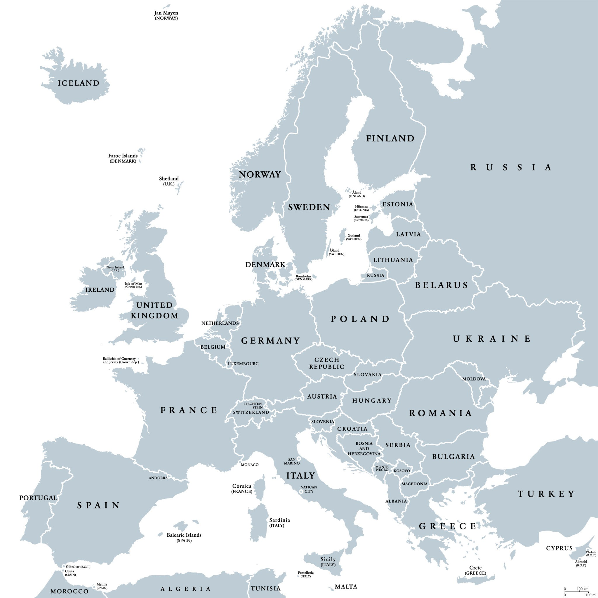
CLASS NOTICES
Class Text
Our class text ‘The Phoenix Code’ by Helen Moss. We will also be looking at space poems from ‘Spaced Out’ by Brian Moses and James Carter.
Reading
All children will read for at least 10 minutes every day in school and we hope parents will do the same at home. We would appreciate it if you could talk to your child about what they are reading.
PE
PE will take place on a Tuesday. We will swim on Thursdays. Children can come to school in their kit (jogging bottoms/PE shorts/leggings and t-shirt/jumper with trainers) on PE days.
Homework
Homework will be sent out every Thursday with it returning back into school by the following Tuesday. If you have any questions about the homework, please come and talk to us. Each week your child will be given a set of spellings to practice at home.
Please ensure your child brings in a water bottle, school jumper/cardigan and coat everyday.
Class Curriculum Information
Year 5
Autumn Term 2
2025/2026
Europe

Slide 2


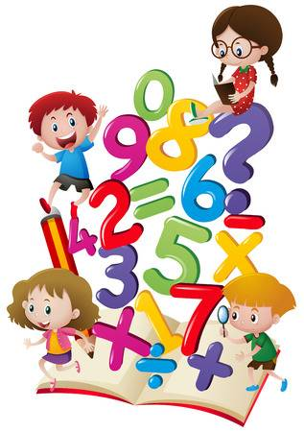
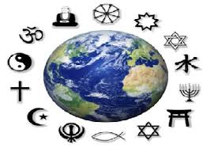
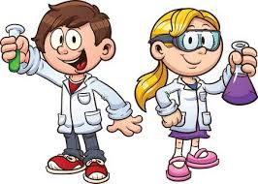


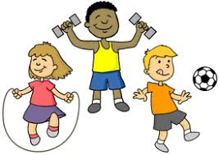
ENRICHMENT AREAS OF LEARNING
ENRICHMENT AREAS OF LEARNING
English | In English this term we will be focusing on inference and retrieval skills in reading. In writing, we will continue to develop our use of dialogue to show the characters personality and actions. We will write a new scene for our class text and begin to look at poetry, learning and adapting poems.
Maths | In Maths, we will be learning about adding and subtracting fractions and converting them between improper fractions and mixed numbers. We will also recap our addition and subtraction knowledge.
Science | We will be building on our Year 4 learning of solids, liquids and gases by exploring mixtures and solutions as part of our materials topic. As part of this learning, we will carry out a range of related investigations in class.
Computing | This half-term we will be learning how to film and edit video. We will use a range of filming techniques to create a short advert for European countries.
Geography and History | We will use atlas to build on our knowledge of the world. We will learn about the hemispheres, the equator and compass points. Then we will zoom into Europe and apply this knowledge to countries in Europe. We will also learn about human and physical features in different countries.
R.E. | This term we will be continuing to focus on the key question ‘What does it mean to be a Muslim in Britain today?’. We will learn about fasting and pilgrimage and describe what the Mosque is used for.
D.T/ Art | In Art, we will be drawing self portraits and learning how to use mixed media to create an interesting and exciting portrait. We will also use photographs of ourselves in our pictures, manipulating the image to create our works of art.
P.E. | In swimming we will learn front crawl and backstroke. Some children will learn doggy paddle and improve their water confidence. In netball we will learn the different positions and how to control the ball and pass safely.

